Slide 1

Chapter 10 Classification and Clustering
SEG301m

Slide 2
Objectives
Techniques used to support search process.
How to cluster/classify information

Slide 3
Contents
10.1 Classification
10.2 Clustering

Slide 4
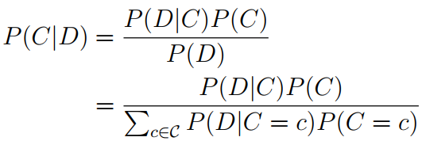
10.1 Classification: Naïve Bayes
A framework for a probabilistic retrieval model: Bayes’ Rule
where C and D arerandom variables

Slide 5
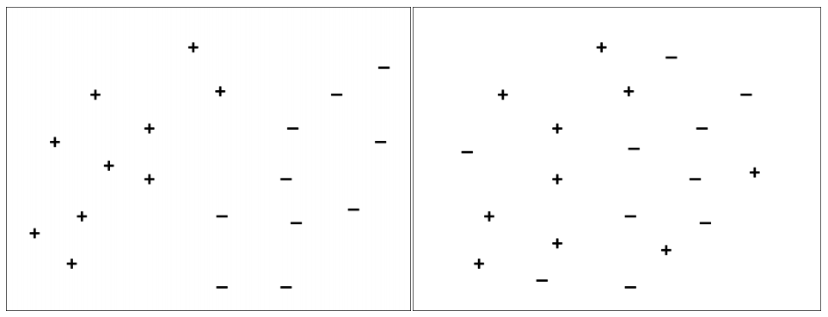
10.1 Classification: Support Vector Machines
Based on geometric principles
Two cases: The data set on the left is linearly separable, whereas the one on the right is not.

Slide 6
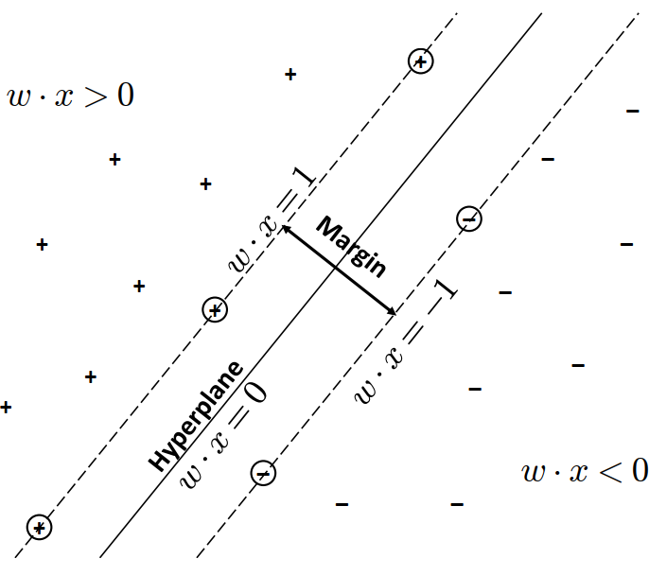

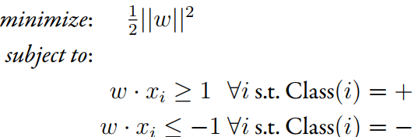
10.1 Classification: Support Vector Machines
Linearly separable data
Find the hyperplane w

Slide 7

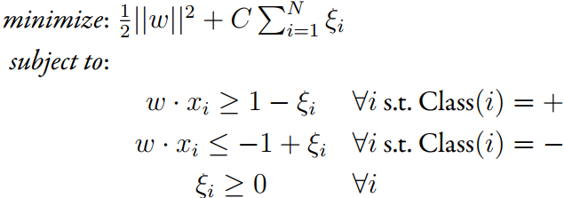
10.1 Classification: Support Vector Machines
Non-linearly separable data
adding a penalty factor to the problem that accounts for training instances that do not satisfy the constraints of the linearly separable formulation.
Hinge loss function
Find the hyperplane w

Slide 8
10.1 Classification: Evaluation
The most commonly used are accuracy and the F measure
Two major differences between evaluating classification tasks and other retrieval tasks
The notion of “relevant” is replaced with “is classified correctly.”
Microaveraging which is not commonly used to evaluate retrieval tasks is widely used in classification evaluations
Notes:
accuracy,6 precision, recall, the F measure, and ROC curve analysis

Slide 9
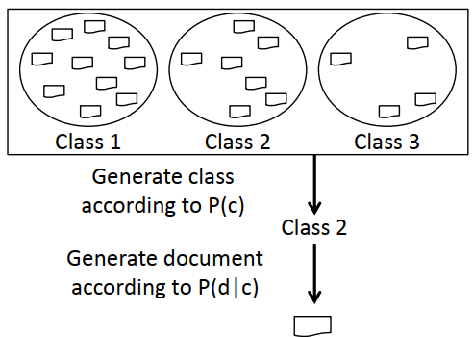
10.1 Classification: Classifier and Feature Selection
The Naïve Bayes classifier is an example of a wider class of probabilistic models called generative models
Generative process used by the Naïve Bayes model. First, a class is chosen according to P(c), and then a document is chosen according to P(d|c).

Slide 10
10.1 Classification: Classifier and Feature Selection
As the number of training examples grows?
The power of the generative model can be limited by simplifying distributional assumptions, such as the independence assumption in the Naïve Bayes classifier → discriminative models
Discriminative models: model the class assignment problem given a document as input → they discriminate between class label
Support vector machines are an example of a discriminative model

Slide 11
10.1 Classification: Classifier and Feature Selection
Non-parametric classifiers: used when there is a large number of training examples.
Let the data “speak for itself ” by eliminating all distributional assumptions
Nearest neighbor classifier is an example of non-parametric classifiers

Slide 12
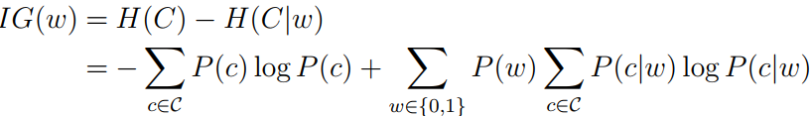
10.1 Classification: Feature selection
How large is dimensional feature space?
Necessarites techniques for pruning the feature space: feature selection techniques
Information gain
Notes:
for very large vocabularies

Slide 13

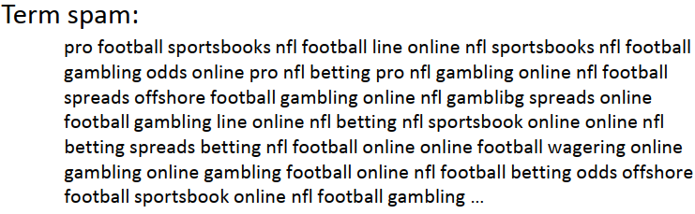
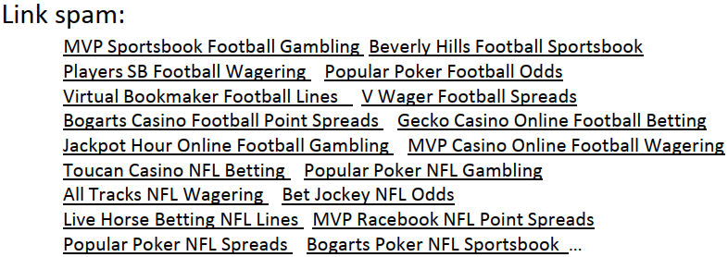
10.1 Classification: Spam, Sentiment, and Online Advertising
The two top-level categories of the taxonomy are link spam and term spam
Notes:
(Ntoulas et al. 2006)

Slide 14
10.1 Classification: Spam, Sentiment, and Online Advertising
Using machine learning techniques for sentiment classification
The features used in the classifiers were unigrams, bigrams, part-of speech tags, adjectives, and the position of a term within a piece of text
Notes:
Pang et al. (2002)

Slide 15
10.1 Classification: Spam, Sentiment, and Online Advertising
Sponsored search and content match are two different advertising models widely used by commercial search engines
One could learn a Naïve Bayes model or use SVMs: problem is very slow to classify an item into one of several thousand classes
Using cosine similarity with tf.idf weighting to match queries (or web pages) to semantic classes.

Slide 16
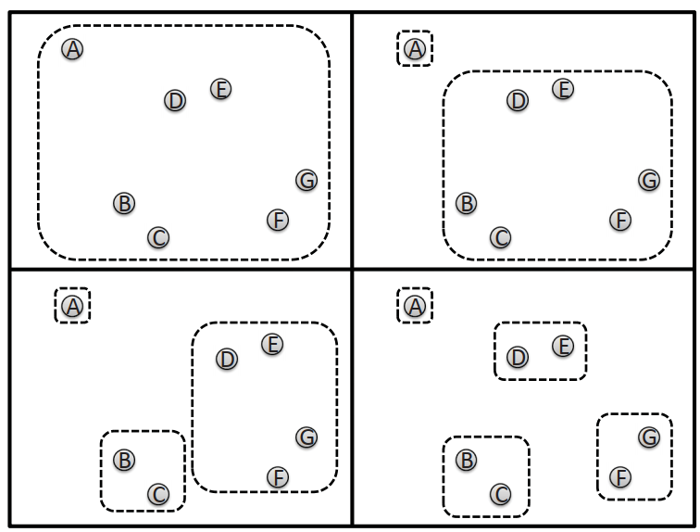
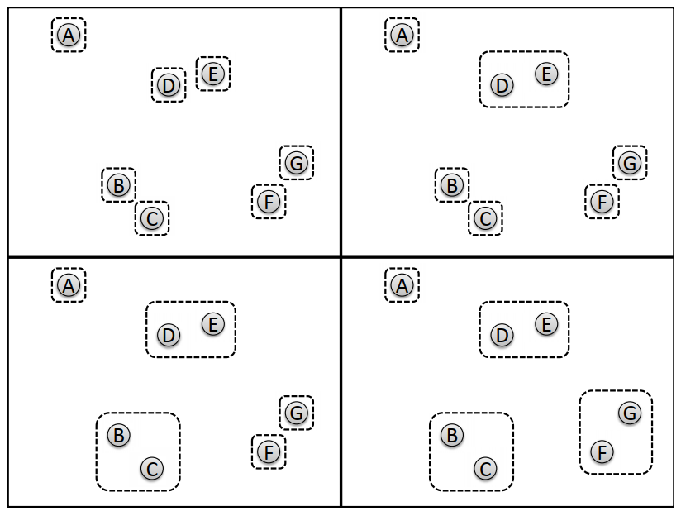
10.2 Clustering: Hierarchical Clustering
Hierarchical clustering is a clustering methodology that builds clusters in a hierarchical fashion
Divisive clustering: top-down
Agglomerative clustering: bottom-up

Slide 17


10.2 Clustering: K-Means Clustering
The goal of the K-means algorithm is to find the cluster assignments, represented by the assignment vector A[1], . . . , A[N], that minimize the following cost function:

Slide 18
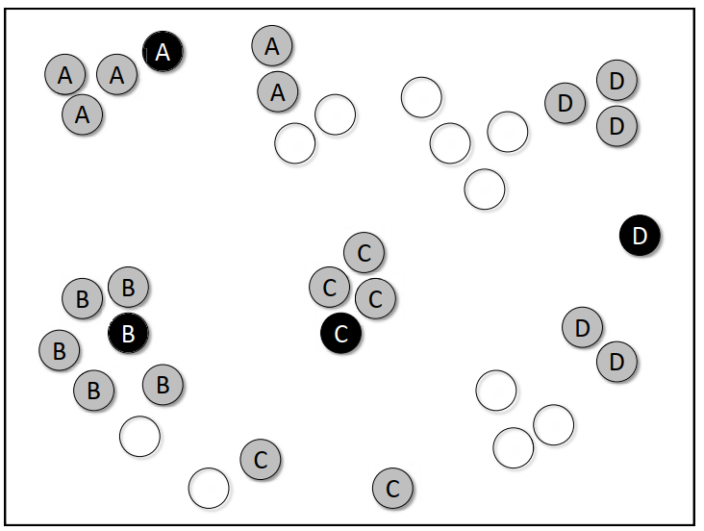
10.2 Clustering: K Nearest Neighbor Clustering
Using nearest neighbor clustering with K = 5

Slide 19

10.2 Clustering: Evaluation
This measure is ofen microaveraged across
Instances, which results in the following measure of precision:
where |MaxClass(Ci)| is the total number of instances in cluster Ci with the label MaxClass(Ci)

Slide 20
10.2 Clustering: How to Choose K
The problem of choosing K is one of the most challenging issues involved with clustering, since there is really no good solution.
No magical formula exists that will predict the optimal number of clusters to use in every possible situation.
Instead, the best choice of K largely depends on the task and data set being considered.
Therefore, K is most often chosen experimentally.

Slide 21
10.2 Clustering: Clustering and Search
Clustering has been used in a number of search engines for organizing the results
Clustering is also able to discover structure in the result set for arbitrary queries that would not be possible with a classifcation algorithm

Slide 22
Exercise
Use the k-means algorithm and the Euclidean distance to cluster the following 10 bidimensional items into 3 clusters: A = (2,10), B = (4,5), C = (3,2), D = (9,4), E = (3,7), F = (5,5), G = (6,4), H = (1,9), I = (1,2), J = (4,9)
Calculate the centroid, diameter, and radius of the three clusters

Slide 23
Summary
Classification: Navie bayes, Support vector machines, Evaluation, Classfier and feature selection, spam, sentiment and online advertising
Clustering: Hierachical and K-meas clustering, K-nearest neighbor clustering, evaluation, how to choose K, clustering and Seach

